Slide 1
Sensitivity Analysis
Lecture 9
Chapter 3: Optimization
Institute of Engineering
Asst. Prof. Anita Prajapati, Ph.D.
30 June 2023

Slide 2
Sensitivity Analysis and the Simplex Method
Chapter 4
4-<number>

Slide 3
Introduction
When solving an LP model we assume that all relevant factors are known with certainty.
Such certainty rarely exists.
Sensitivity analysis helps answer questions about how sensitive the optimal solution is to changes in various coefficients in an LP model.
4-<number>

Slide 4
General Form of a
Linear Programming (LP) Problem
MAX (or MIN): c₁X₁ + c₂X₂ + … + c_{n}X_{n}
Subject to: a₁₁X₁ + a₁₂X₂ + … + a_{1n}X_{n} <= b₁
:
a_{k1}X₁ + a_{k2}X₂ + … + a_{kn}X_{n} <= b_{k}
:
a_{m1}X₁ + a_{m2}X₂ + … + a_{mn}X_{n} = b_{m}
How sensitive is a solution to changes in the c_{i}, a_{ij}, and b_{i}?
4-<number>

Slide 5
Approaches to Sensitivity Analysis
Change the data and re-solve the model!
  Sometimes this is the only practical approach.
Solver also produces sensitivity reports that can answer questions about:
  amounts objective function coefficients can change without changing the solution.
  the impact on the optimal objective function value due to changes in various constrained resources.
  the impact on the optimal objective function value due to forced changes in certain decision variables.
  the impact on the optimal solution due to changes in constraint coefficients
4-<number>

Slide 6
Software Note
When solving LP problems, be sure to select the “Assume Linear Model” option in the Solver Options dialog box as this allows Solver to provide more sensitivity information than it could otherwise do.
4-<number>

Slide 7
Once Again, We’ll Use The
Blue Ridge Hot Tubs Example...
MAX: 350X₁ + 300X₂ } profit
S.T.: 1X₁ + 1X₂ <= 200 } pumps
9X₁ + 6X₂ <= 1566 } labor
12X₁ + 16X₂ <= 2880 } tubing
X₁, X₂ >= 0 } non-negativity
4-<number>

Slide 8
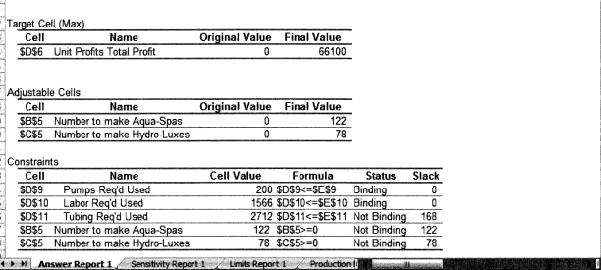
The Answer Report
See file Fig4-1.xls
4-<number>

Slide 9
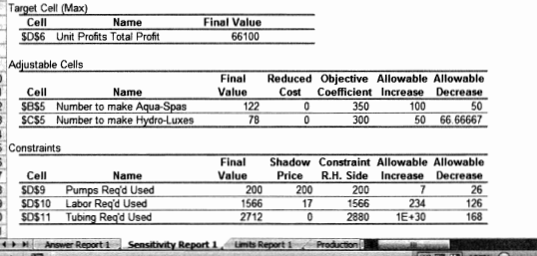
The Sensitivity Report
See file Fig4-1.xls
4-<number>

Slide 10
Changes in Objective Function Coefficients
Values in the “Allowable Increase” and “Allowable Decrease” columns for the Changing Cells indicate the amounts by which an objective function coefficient can change without changing the optimal solution, assuming all other coefficients remain constant.
4-<number>

Slide 11
Alternate Optimal Solutions
Values of zero (0) in the “Allowable Increase” or “Allowable Decrease” columns for the Changing Cells indicate that an alternate optimal solution exists.
4-<number>

Slide 12
Changes in Constraint RHS Values
The shadow price of a constraint indicates the amount by which the objective function value changes given a unit increase in the RHS value of the constraint, assuming all other coefficients remain constant.
Shadow prices hold only within RHS changes falling within the values in “Allowable Increase” and “Allowable Decrease” columns.
Shadow prices for nonbinding constraints are always zero.
4-<number>

Slide 13
Comments About Changes in Constraint RHS Values
Shadow prices only indicate the changes that occur in the objective function value as RHS values change.
Changing a RHS value for a binding constraint also changes the feasible region and the optimal solution (see graph on following slide).
To find the optimal solution after changing a binding RHS value, you must re-solve the problem.
4-<number>

Slide 14
X₂
How Changing the RHS Value of a Constraint Can Change the Feasible Region and Optimal Solution
250
Suppose available labor hours increase from 1,566 to 1,728
200
150
old optimal solution
old labor constraint
100
new optimal solution
50
new labor constraint
0
0
50
100
150
200
250
X₁
4-<number>

Slide 15
Other Uses of Shadow Prices
Suppose a new Hot Tub (the Typhoon-Lagoon) is being considered. It generates a marginal profit of $320 and requires:
  1 pump (shadow price = $200)
  8 hours of labor (shadow price = $16.67)
  13 feet of tubing (shadow price = $0)
Q: Would it be profitable to produce any?
  A: $320 - $200*1 - $16.67*8 - $0*13 = -$13.33 = No!
4-<number>

Slide 16
The Meaning of Reduced Costs
The Reduced Cost for each product equals its per-unit marginal profit minus the per-unit value of the resources it consumes (priced at their shadow prices).
Optimal Value of Optimal Value of
Type of Problem Decision Variable Reduced Cost
at simple lower bound <=0
Maximization between lower & upper bounds =0
at simple upper bound >=0
at simple lower bound >=0
Minimization between lower & upper bounds =0
at simple upper bound <=0
4-<number>

Slide 17
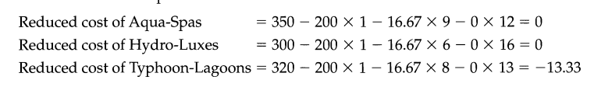
4-<number>

Slide 18
Key Points
The shadow prices of resources equate the marginal value of the resources consumed with the marginal benefit of the goods being produced.
Resources in excess supply have a shadow price (or marginal value) of zero.
The reduced cost of a product is the difference between its marginal profit and the marginal value of the resources it consumes.
Products whose marginal profits are less than the marginal value of the goods required for their production will not be produced in an optimal solution.
4-<number>

Slide 19
Analyzing Changes in Constraint Coefficients
Q: Suppose a Typhoon-Lagoon required only 7 labor hours rather than 8. Is it now profitable to produce any?
  A: $320 - $200*1 - $16.67*7 - $0*13 = $3.31 = Yes!
Q: What is the maximum amount of labor Typhoon-Lagoons could require and still be profitable?
  A: We need $320 - $200*1 - $16.67*L₃ - $0*13 >=0
  The above is true if L₃ <= $120/$16.67 = $7.20
4-<number>

Slide 20
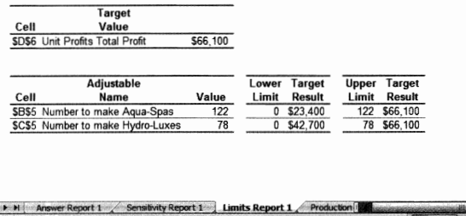
The Limits Report
See file Fig4-1.xls
4-<number>

Slide 21
Simplex Method Summary
The simplex method operates by first identifying any basic feasible solution (or extreme point) for an LP problem, then moving to an adjacent extreme point, if such a move improves the value of the objective function.
When no adjacent extreme point has a better objective function value, the current extreme point is optimal and the simplex method terminates.
The process of moving from one extreme point to an adjacent one is accomplished by switching one of the basic variables with one of the non-basic variables to create a new basic feasible solution that corresponds to the adjacent extreme point.
4-<number>

Slide 22
Assignment 4
Question no.: 5,7,10, 11,12,17,18
Due on 14th July
4-<number>

Slide 23
End of Chapter 4
4-<number>

